Slide 1

Loss Functions in Diffusion Models: A Comparative Study
Master Thesis by Dibyanshu Kumar
Primary Supervisor: Dr. Magda Gregrová
Secondary Supervisor: Dr. Andreas Lehrmann

Slide 2
Agenda
Introduction
Context
Research Focus and Motivation
Background
Generative Modeling
Complexities in modeling
Framework for a good generative model
Diffusion Models
Probabilistic Denoising Models
Score Modeling
Loss Formulation in different target objectives
Equivalence of Loss Functions
Experiments
Datasets
Model Architecture
Evaluation Metrics
Results and Discussion
Conclusion
Summarizing the findings
Future scope

Slide 3
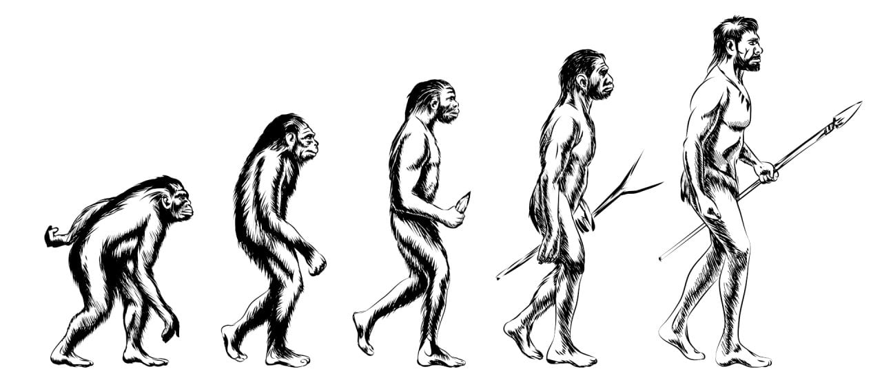
Introduction
Normalizing Flows
Variational Autoencoders
Histogram features, GMM
Generative adversarial networks
Mid 20th century
Diffusion Models
Autoregressive Models

Slide 4

Questions ?
Why there are different target objectives?
Why the loss function we derived is different than what we practically use?
What is the advantage of choosing one over another?
Are they comparable to each other?
Do they perform or give similar results?

Slide 5
Motivation and Research Area
Score Modeling
Score matching objective
Song et al. [2019]
DDPM
Noise prediction objective
Ho et al. [2020]
Unified Framework
Progressive Distillation
v objective
Salimans & Ho. [2024]
VDM
ELBO x objective
Kingma et al. [2021]

Slide 6

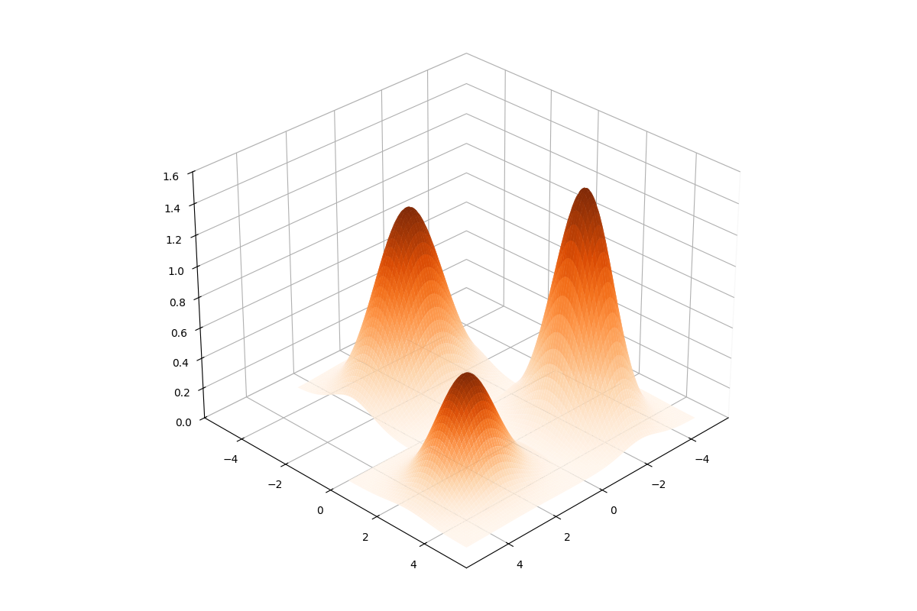
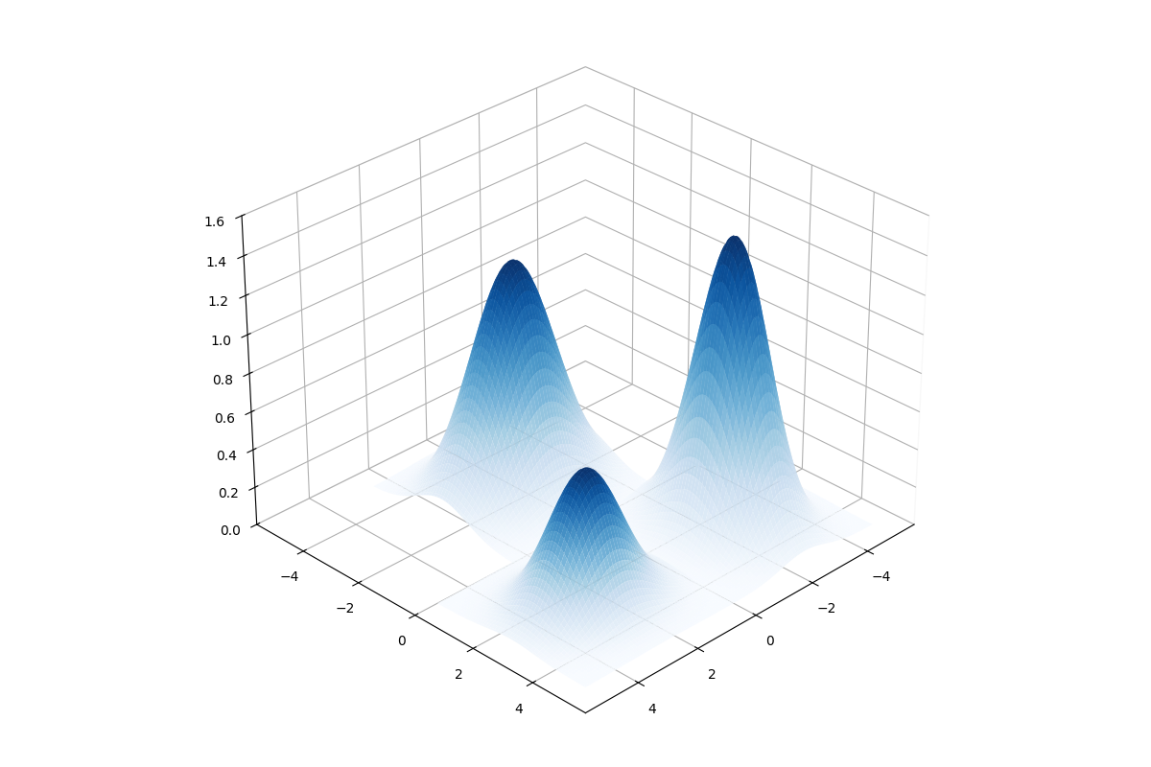
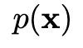
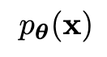


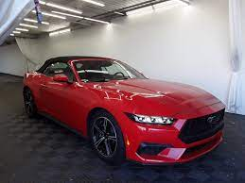
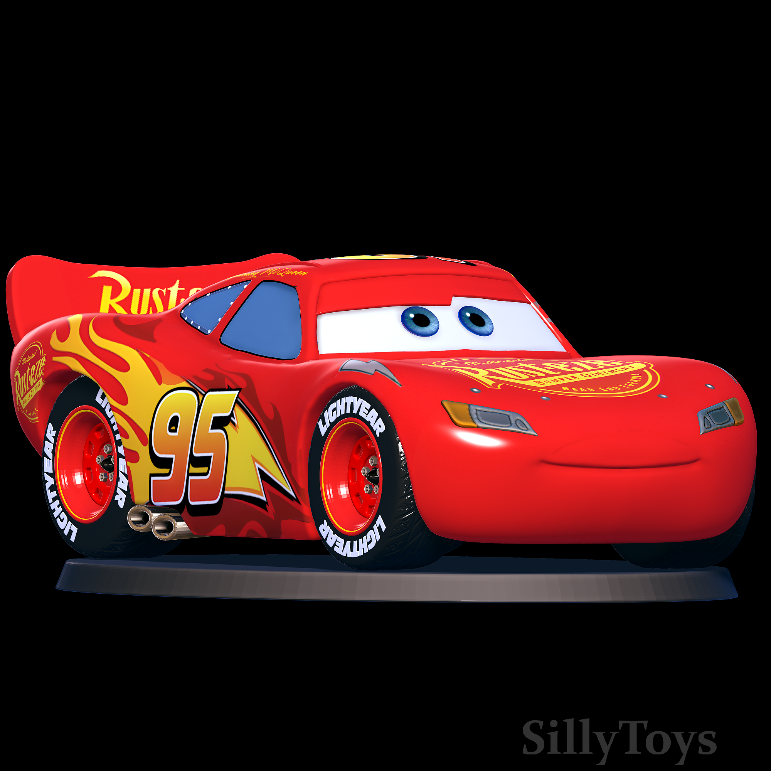
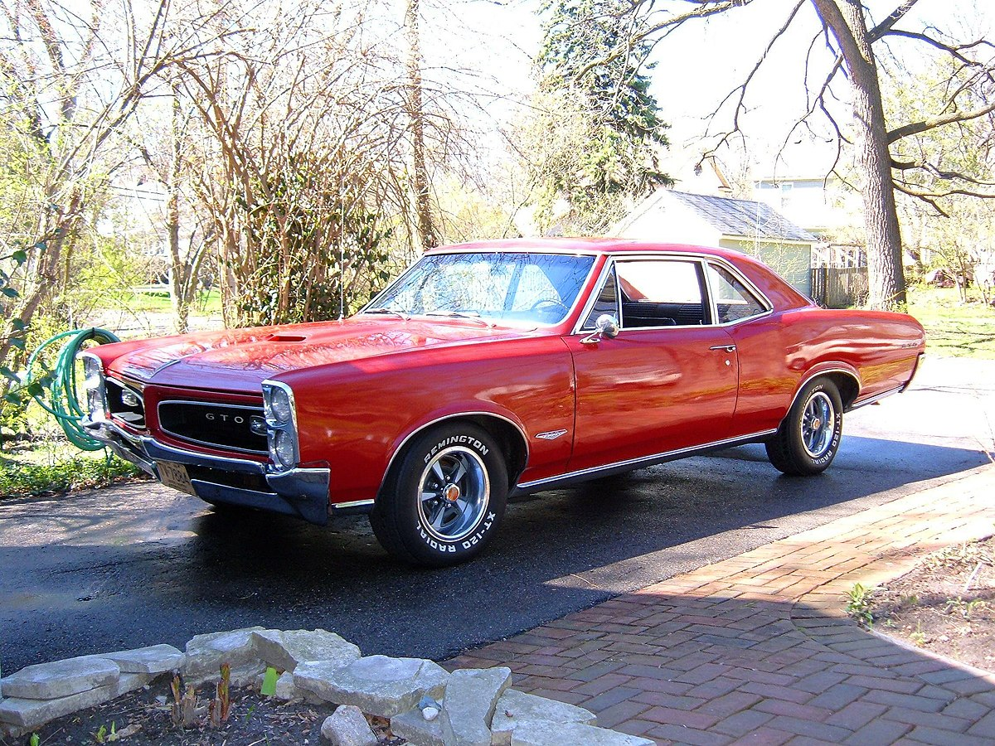
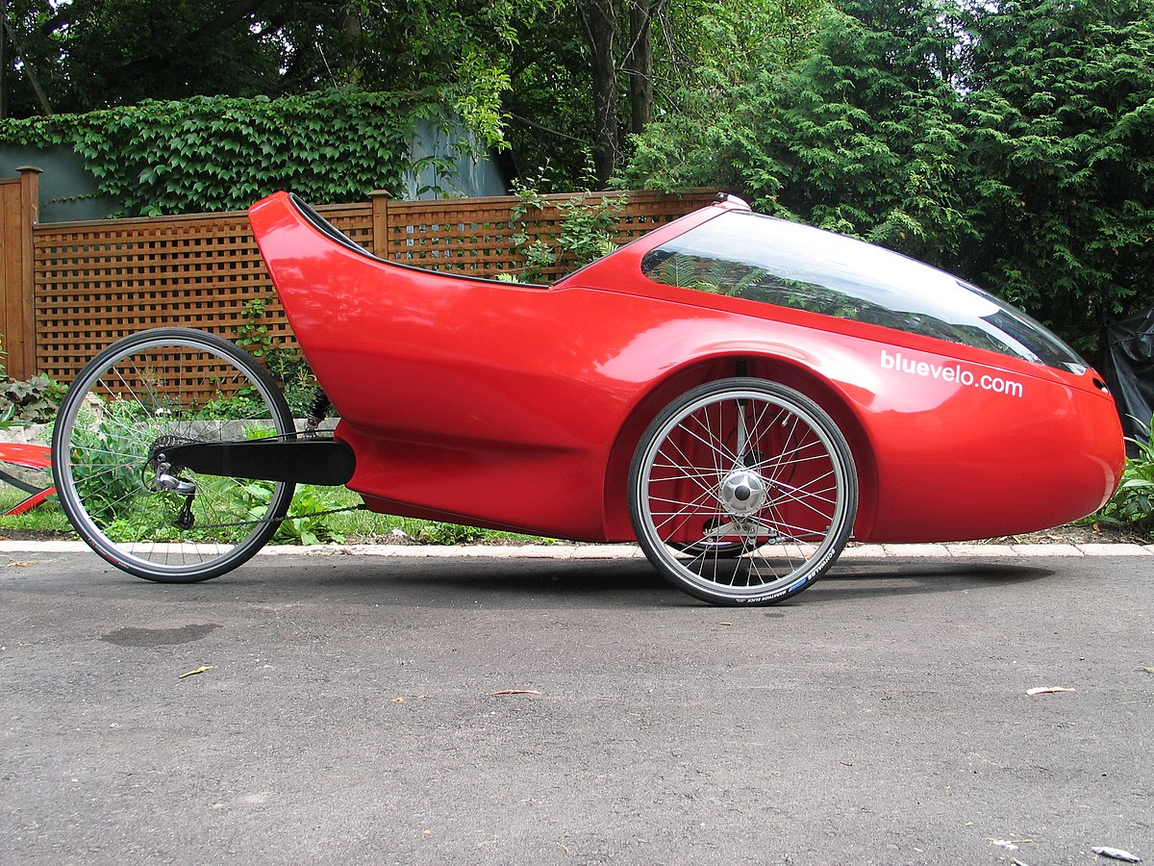
Background
Generative modeling is a branch of machine learning that is used to create models
which can generate new data samples resembling a given dataset.
In machine learning we often assume that the datapoints are IID samples drawn from an underlying data distribution, since we don’t know the analytical form of this, therefore we model it.
Generate
novel sample
Evaluate probability
Low
High
Detect outliers

Slide 7
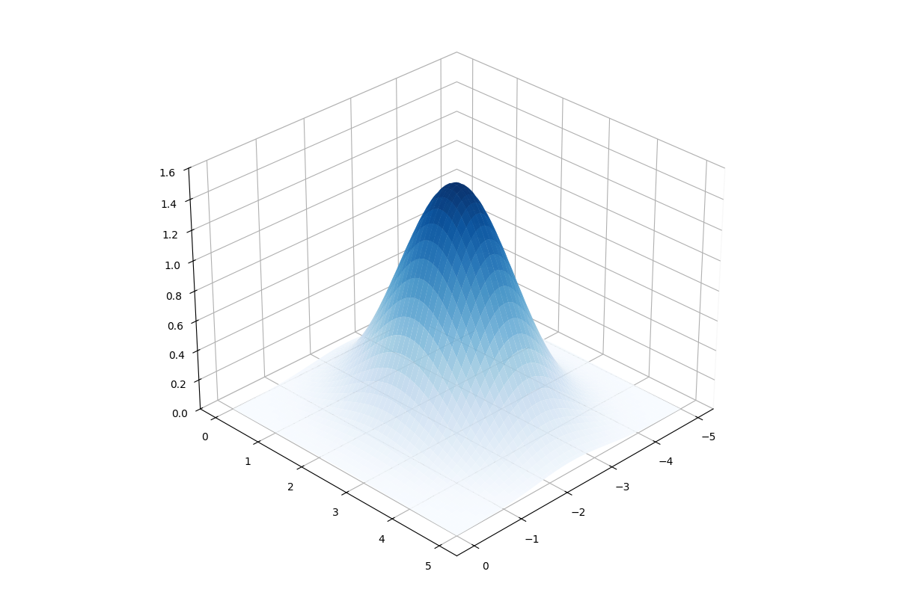
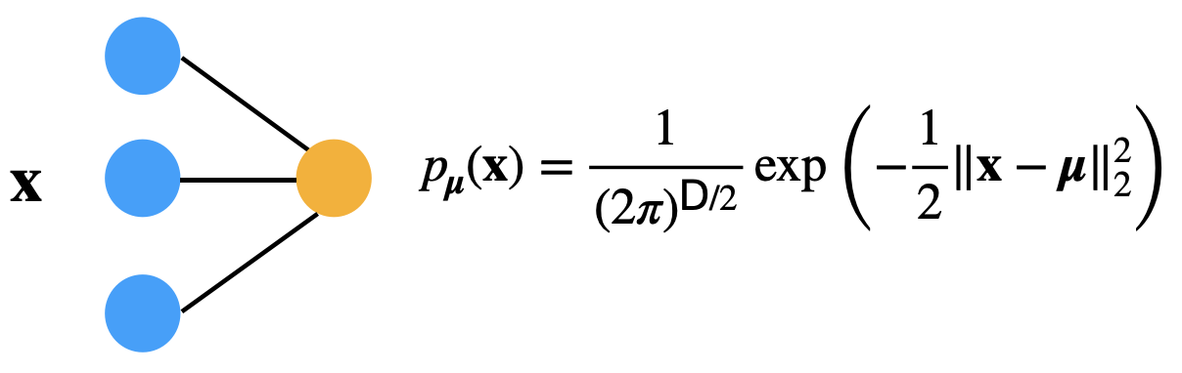
The simplest way to model our data distribution is to approximate it using a Gaussian
distribution where $μ$ is the tunable mean parameter.
Though simple to use, Gaussian models are most often unable to capture the complexity
of data.

Slide 8
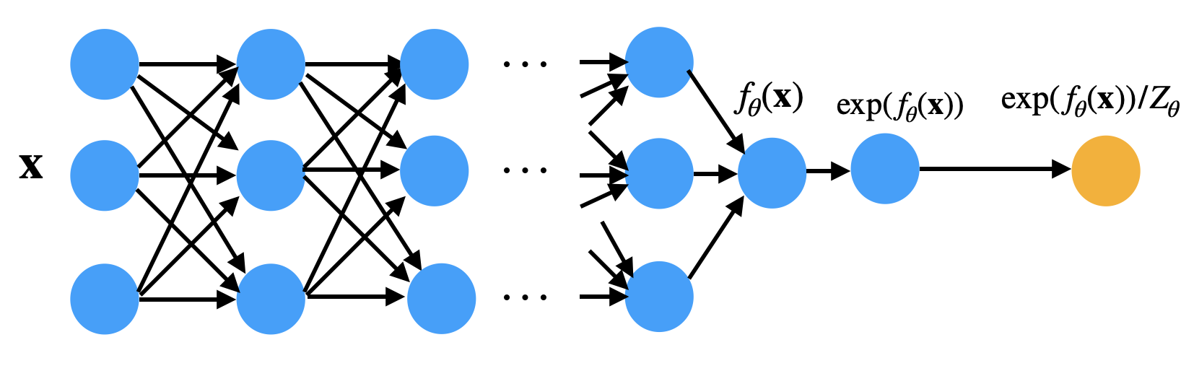
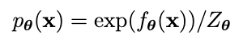
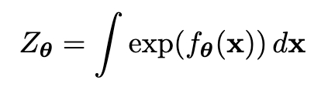
A better way is to use DNN which allows us to model more complex and flexible
probability distributions.
Since the output of a DNN is not a valid probability density, therefore we apply the exponential
function to ensure it is positive and divide by a constant to ensure the result integrates to 1.
where

Slide 9


Intractability of Normalizing Constant
Broadly classifed into
Let’s solve this !
Approximating the Normalizing Constant
Restricting the neural network models
Modeling the generation process

Slide 10
Approximating the Normalizing Constant
Restricting the neural network models
Modeling the generation process
Energy Based Models
AR
Flows
VAE
GAN
Use MCMC methods to sample from the model distribution
AR
Factorize joint into product of conditionals
Flows
Invertible transformation between prior and data distribution
VAE
Maximize lower bound to the likelihood
Train generator and discriminator in an adversarial setup
Flexible but introduces approximation errors
Produces good quality samples but does not evaluate probability explicitly
Sequential
dependency
Architectural constraints
Generate blurry samples

Slide 11
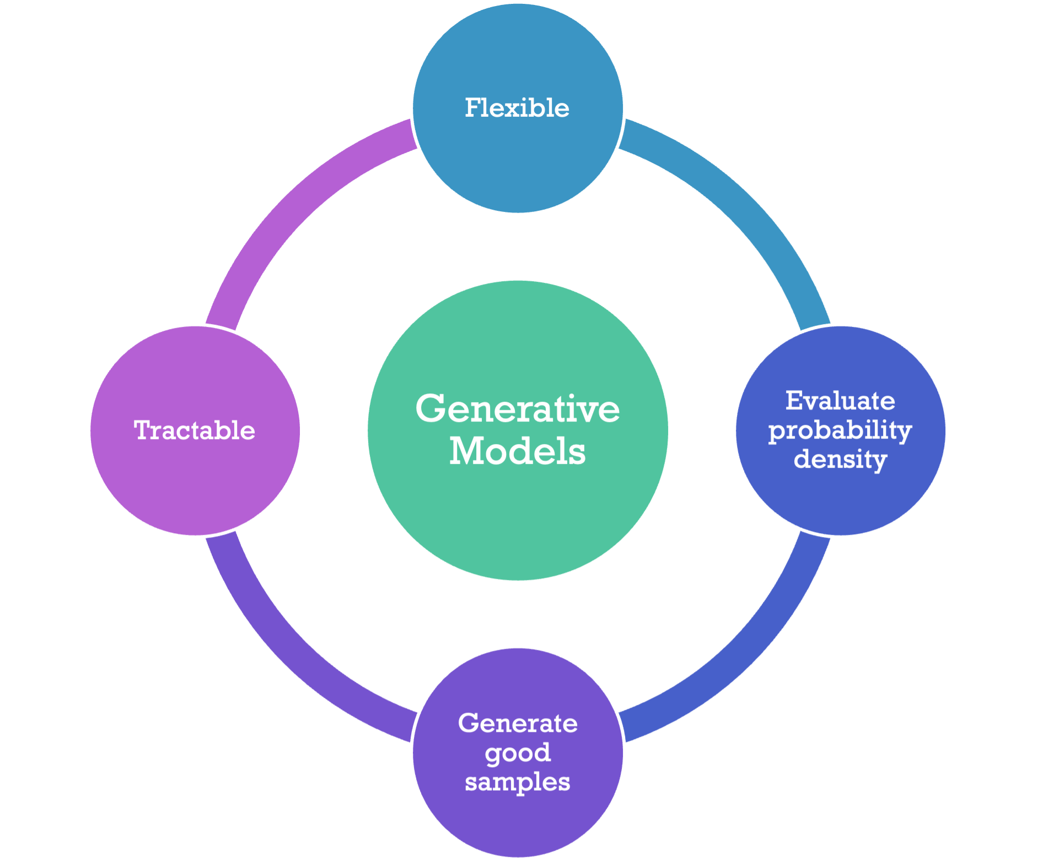
Framework for an efficient generative model
Diffusion models fulfills these key criterias as:
They can use flexible architectures like U-Nets and transformers.
Variational lower bound maximization ensures computational efficiency.
Reverse process enables probability density evaluation.
Generates diverse, high-quality samples closely matching true data.

Slide 12
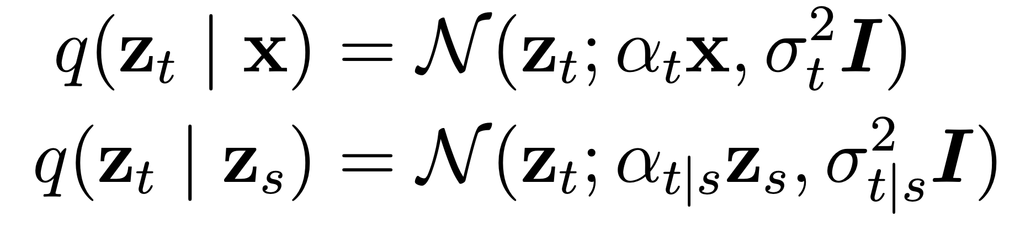
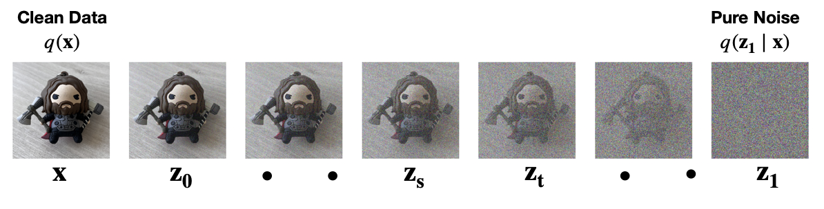
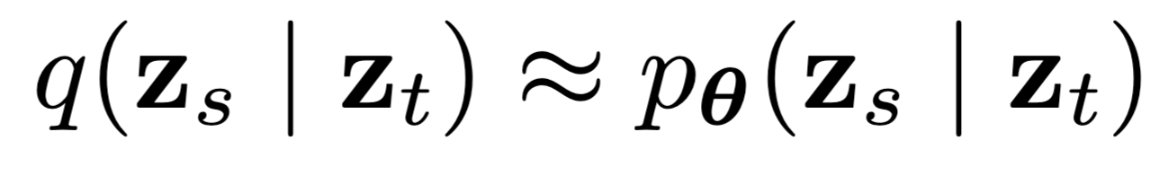
Diffusion models as Probabilistic Denosing models
Forward Diffusion (Fixed Markov process)
Reverse Generative Process (Modeled as Markov process)

Slide 13
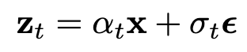
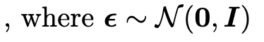
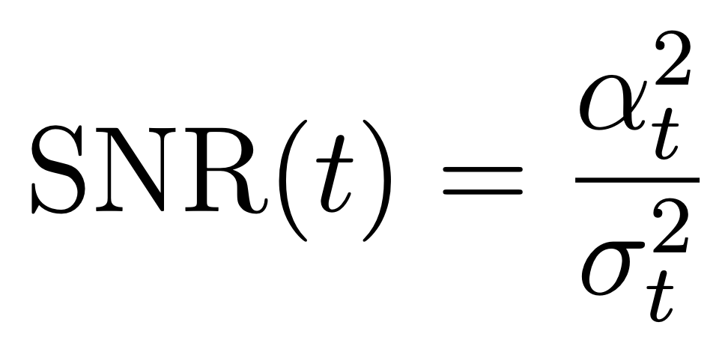
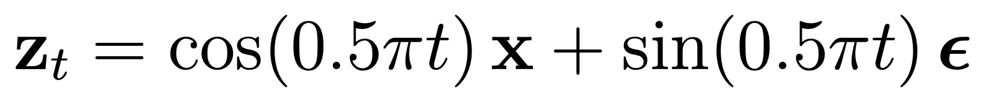
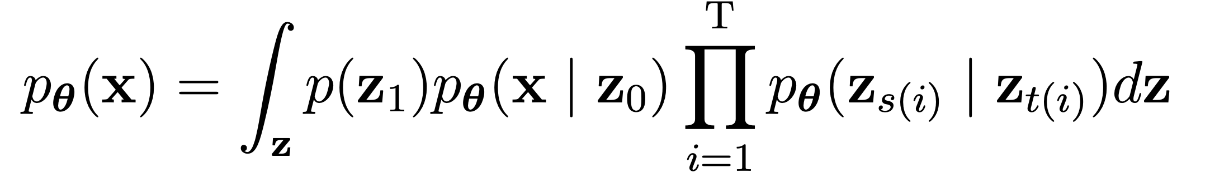
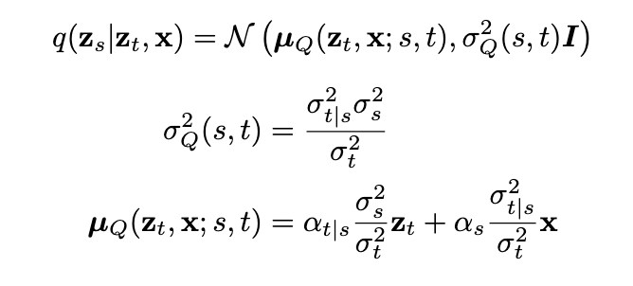
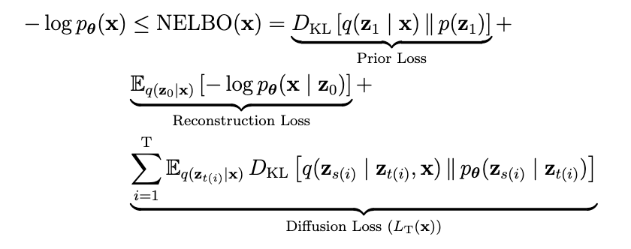
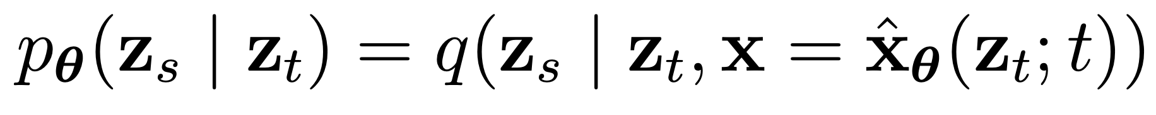
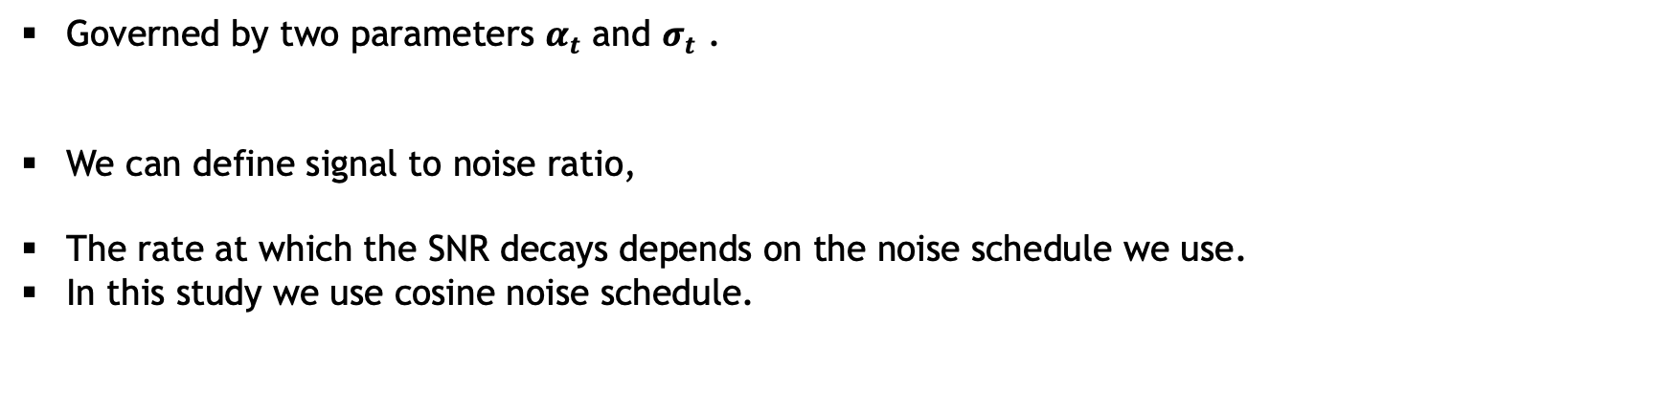
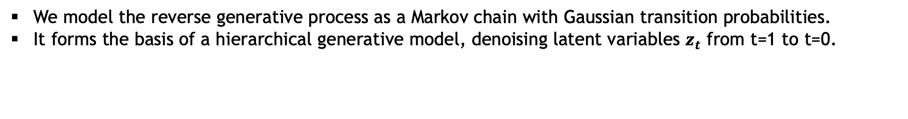
Forward Diffusion Process:
Governed by two parameters $α_{t}$ and $σ_{t}$ .
We can define signal to noise ratio,
The rate at which the SNR decays depends on the noise schedule we use.
In this study we use cosine noise schedule.
Reverse Generative Process:
We model the reverse generative process as a Markov chain with Gaussian transition probabilities.
It forms the basis of a hierarchical generative model, denoising latent variables $z_{t}$​ from t=1 to t=0.

Slide 14
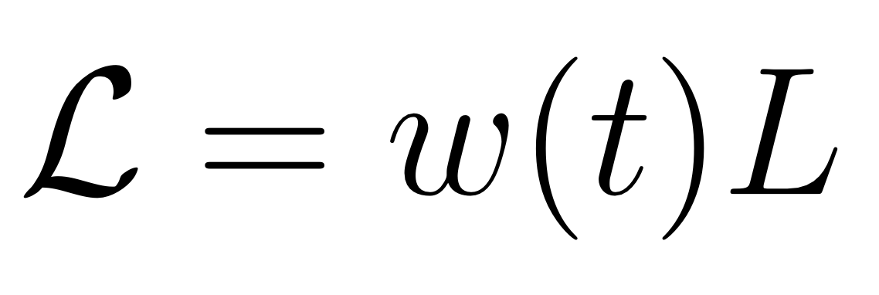
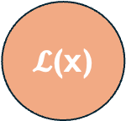
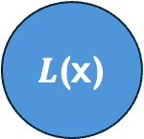


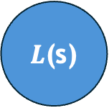
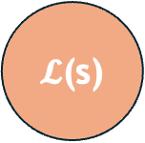
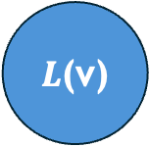
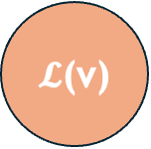
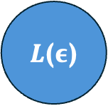
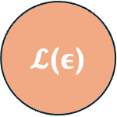
Loss Formulation
NELBO ($L$)
Weighted ($𝓛$)
$L$(x)
$L$($ε$)
$L$(v)
$L$(s)
$𝓛$(x)
$𝓛$($ε$)
$𝓛$(v)
$𝓛$(s)

Slide 15
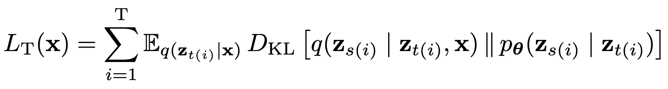
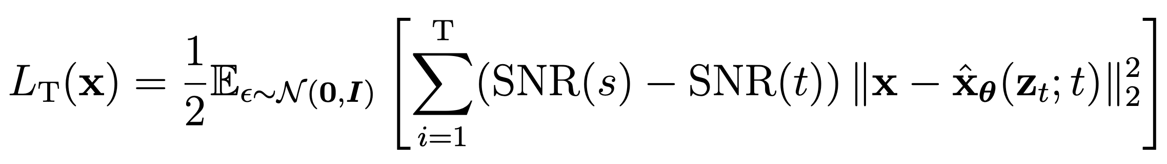
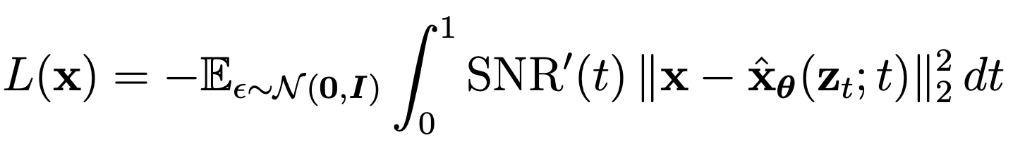
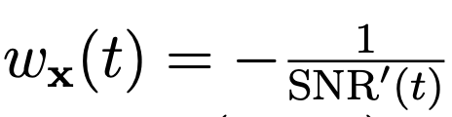
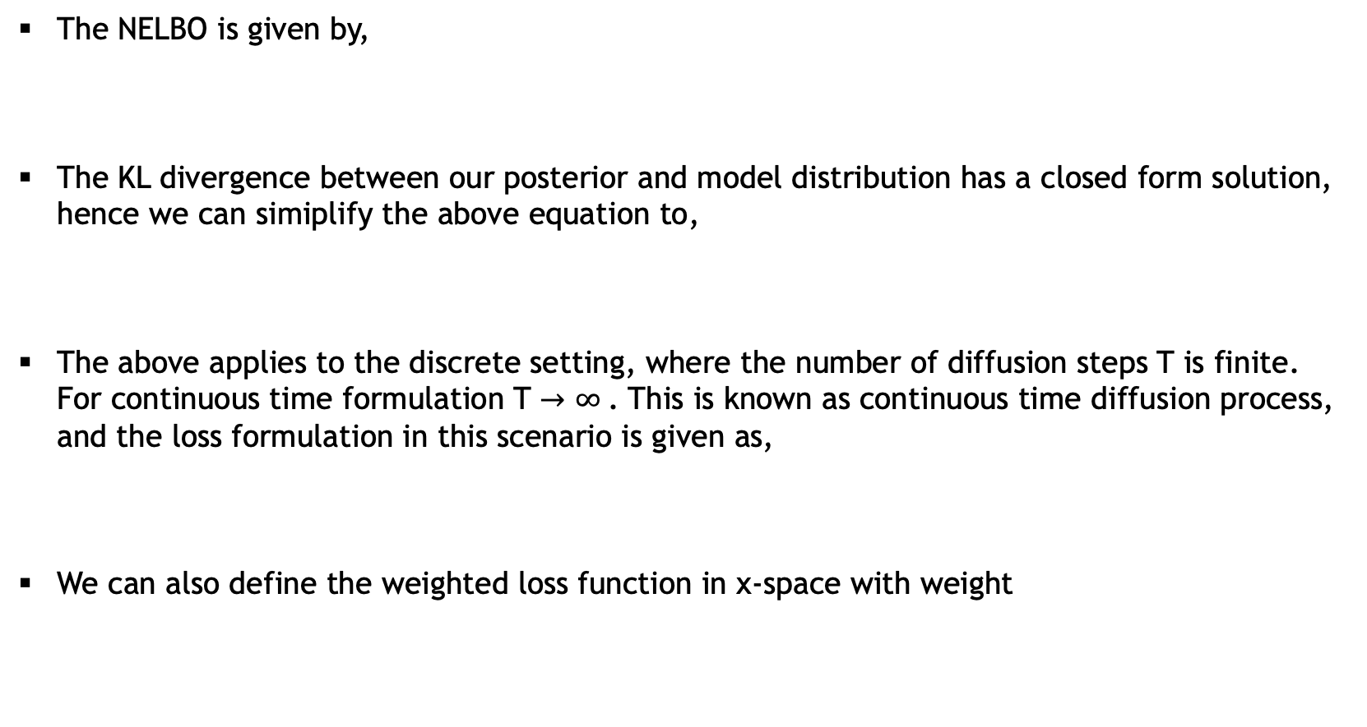
Loss in x-space
The NELBO is given by,
The KL divergence between our posterior and model distribution has a closed form solution, hence we can simiplify the above equation to,
The above applies to the discrete setting, where the number of diffusion steps T is finite. For continuous time formulation T $→$ $∞$. This is known as continuous time diffusion process, and the loss formulation in this scenario is given as,
We can also define the weighted loss function in x-space with weight

Slide 16
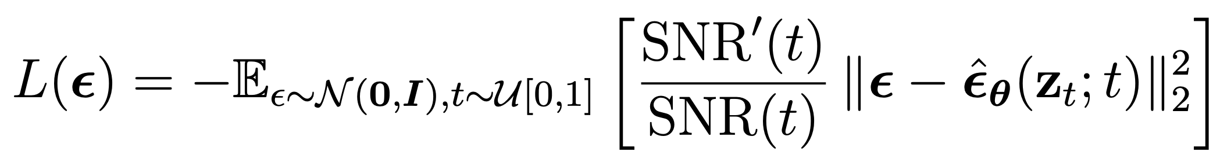
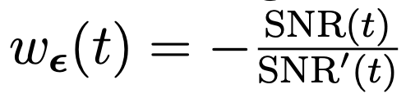
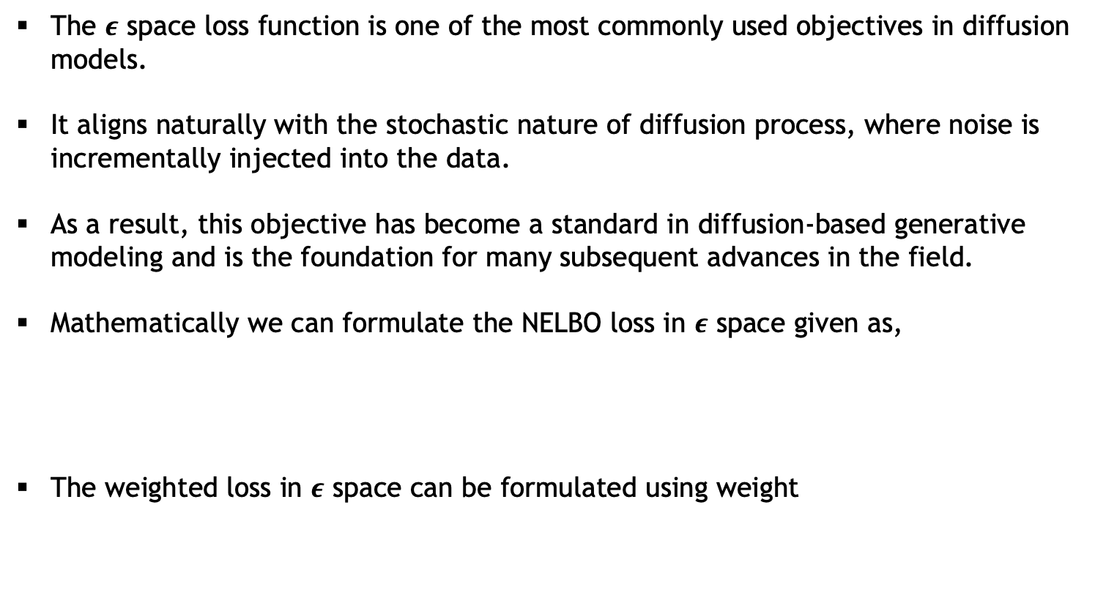

Loss in $ε$-space
The $ε$ space loss function is one of the most commonly used objectives in diffusion models.
It aligns naturally with the stochastic nature of diffusion process, where noise is incrementally injected into the data.
As a result, this objective has become a standard in diffusion-based generative modeling and is the foundation for many subsequent advances in the field.
Mathematically we can formulate the NELBO loss in $ε$ space given as,
The weighted loss in $ε$ space can be formulated using weight

Slide 17
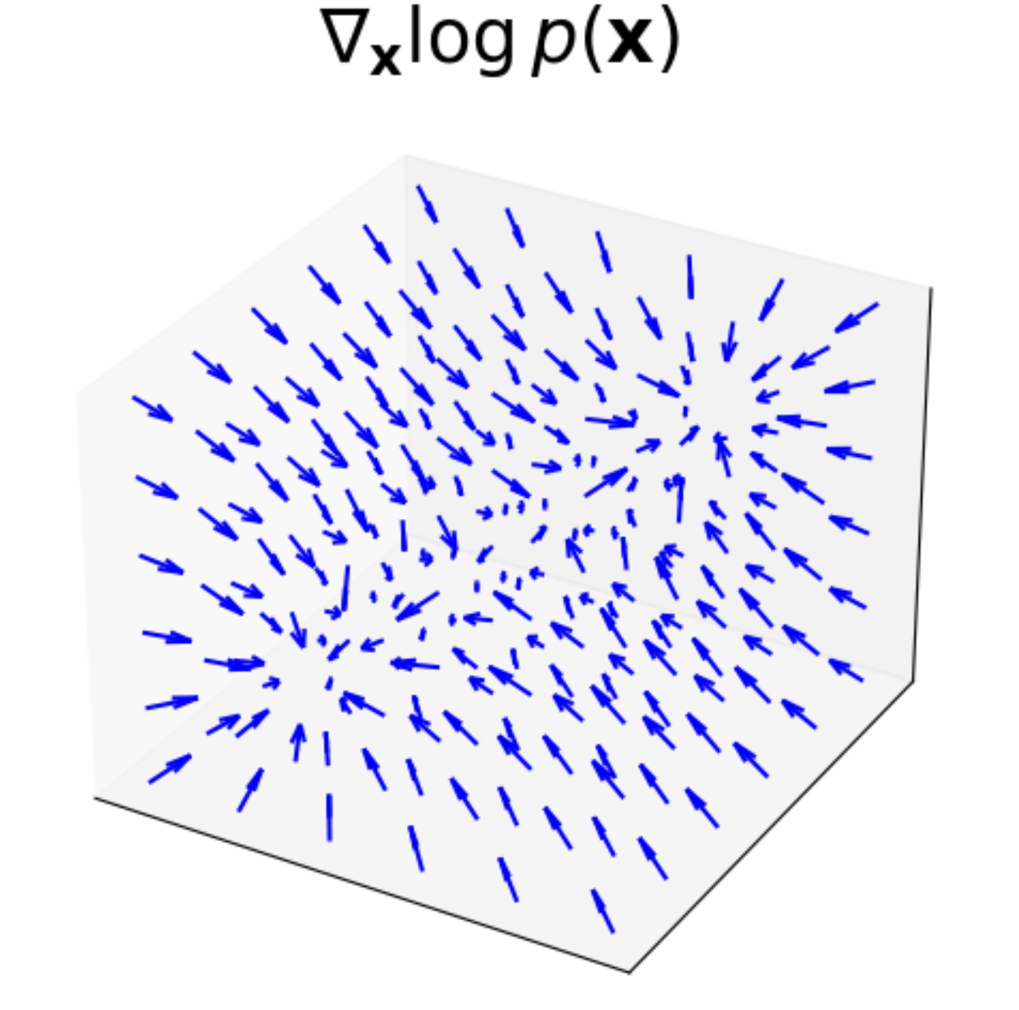
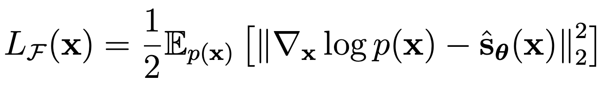
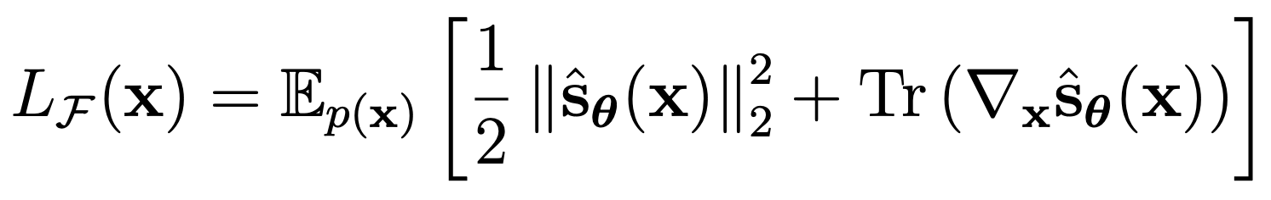
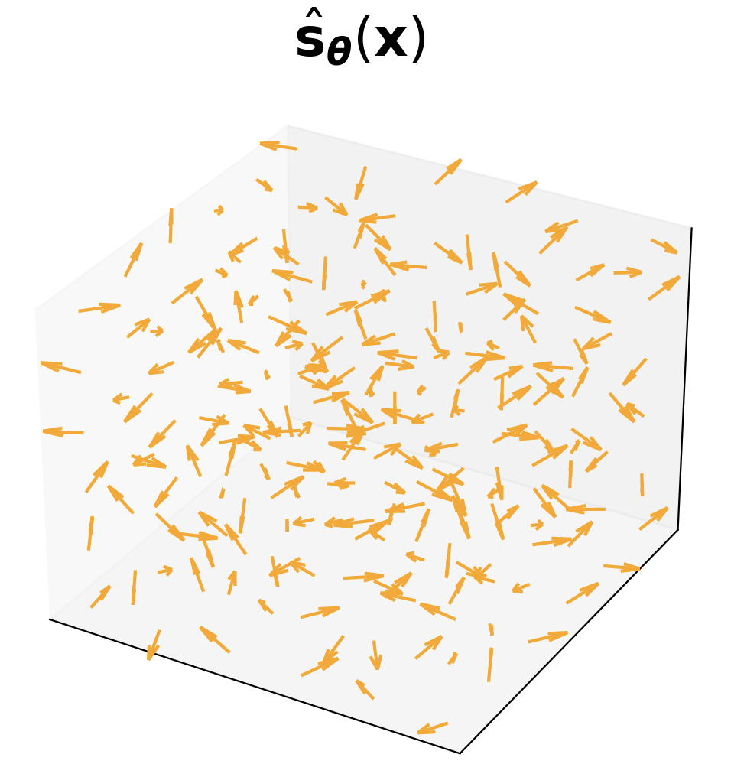
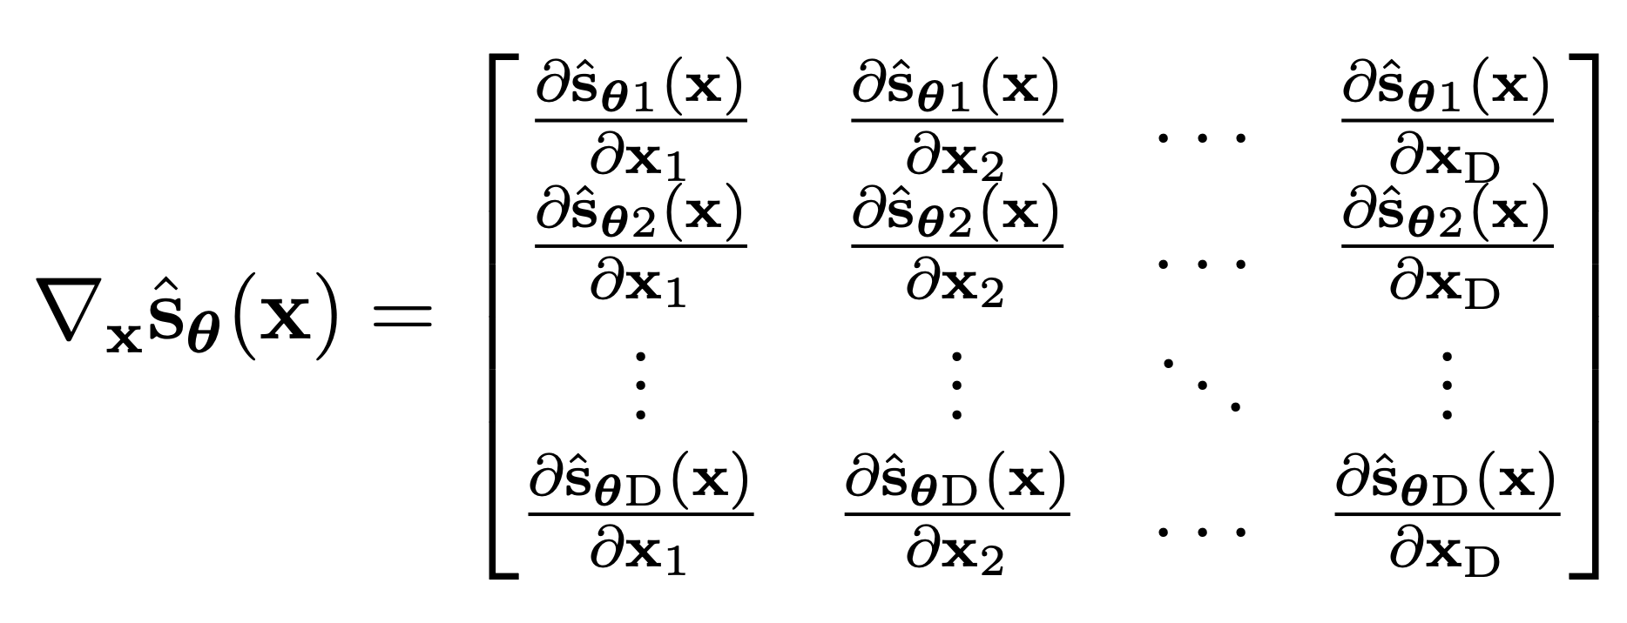





Diffusion models as score models
Score Function ?
$∇_{\text{x}}log{p}($x)
Score matching
Challenge

Slide 18






Score matching techniques
Sliced score matching: In this we simplify the problem by projecting score function onto randomly sampled one dimensional directions. The idea here is that, two vector fields are close in high-dimensional space if their projections onto many random directions are also close.
Denoised score matching: The idea behind this is to is to perturb the data x by adding noise , to get a noisy version z and therefore learn the score of the perturbed distribution which can be analytically derived.
, where

Slide 19



Score matching at multiple noise levels
For sampling using score function we use Langevin dynamics. While this is a good framework, there still exists some challenges.
The score learned via score matching, captures local information near high density regions of the data distribution but provides poor estimates in low density areas.
This issue can be resolved through multi-scale score modeling framework, where the idea is to corrupt the data with Gaussian noise at various levels.
We define a sequence of noise scales,
The perturbed distribution for each noise scale is given by .
The training objective is then to minimize the expected square error across all noise levels.

Slide 20





Loss in s-space
The concept of multiscale score estimation naturally transitions into the formulation of diffusion based generative models.
Unlike score based models which add noise at discrete levels, diffusion-based models incorporate noise progressively over several time steps.
In s-space our goal is to learn a time dependent score model that approximates the true score at time t.
To express the equivalent NELBO loss in s-space, we use Tweedie’s formula.
For a Random Gaussian variable , it is expressed as,
Using Tweedie’s formula to find the true mean of the posterior ,

Slide 21



Using this we formulate the NELBO loss in s-space.
The weighted loss in s space can be formulated using weight
For Gaussian noise perturbation, the ground truth score simplifies to,

Slide 22



Angular parameterization
Angular parameterization in diffusion models was proposed by Salimans and Ho [2024].
In this method we estimate the rate of change in the data distribution (v).
This method proved effective for model distillation where the goal is to reduce the number of sampling steps.
It interprets the noisy data $z_{ϕt}$ on a circular trajectory in a 2D space parameterized by angle $φ_{t}$.
The data evolution can be visualized as motion along this trajectory and can be expressed as,

Slide 23




Loss in v-space
The instantaneous rate of change in data distribution is given as,
Here
Mathematically we formulate the NELBO loss in v-space expressed as,
Similarly we define the weighted loss in v-space using weight

Slide 24


Equivalence of loss Functions
For all the four target objectives (x, $ε$, s, v) we formulated the,
NELBO loss which are equivalent to each other and are comparable.
Weighted loss which essentially removes the SNR scaling associated with the $ℓ_{2}$ loss.
Inorder to compare weighted loss, we formulate the rescaled loss which makes them all equivalent to $ℒ$(x).
In our experiments, we verify whether the mathematical equivalence holds.

Slide 25


Experimental Details
Datasets:
We work on two type of datasets: 2-dimensional synthetic datasets and high dimension image dataset. 2D datasets are simple and requires less computational resources, that allows for various experiments. For experiments of high dimensional image data, we use CIFAR10 which is a widely adopted benchmark in computer vision tasks.
There are four 2D datasets used in these study. Each has a distinct shape and structure. They contain 50K samples each of which 20% are used for testing. The CIFAR10 on the other hand contains 50K training and 10K test images.

Slide 26





Model architecture:
For the 2D dataset we used a simple neural network architecture consisting of 7 fully connected layers, each followed by a ReLU activation function.
To model the image dataset we used UNet based architecture. The UNet architecture is known for its success in handling high dimensional data due to its encoder-decoder structure.
Evaluation metrics for sample quality:
For the samples generated from 2D models we used moment based metrics: mean and covariance distance.
For quality of generated samples from the image model we used the Fréchet Inception Distance (FID) score.

Slide 27
Experimental Results
We evaluate the performance of diffusion models trained with various loss formulations from three primary perspectives.
Loss convergence over epochs
Quality of generated samples
Samples generated from varying sampling steps

Slide 28

Loss convergence over epochs
We first use the weighted loss formulation to train our 2D models. Since they cannot be compared we rescaled them according to the rescaled loss. After rescaling the loss curves align which proves the equivalency.
Weighted loss vs Epochs
Rescaled loss vs Epochs

Slide 29


Next we train the model using the NELBO loss formulations for various target predictions. As they are theoretically equivalent, we expect them to behave similarly in the experiments too.
NELBO loss vs Epochs
For all the four datasets we see a similar behaviour. The loss curves for predictions in the v and $ε$ space are close and so is for the x and s space. However, there is a significant gap between these two groups.

Slide 30


We attribute these variations to differences in SNR scaling of the targets in the NELBO formulation and the variability of target objectives across different timesteps.
Variance of weighted loss across timesteps
SNR-scalings

Slide 31



Generated samples
The quality of generated samples differs from the pattern of loss convergence, indicating that better likelihood estimation doesn't always ensure high sample quality.
Performance of NELBO and weighted loss formulations on 2D datasets
Generated samples using weighted loss (left) and NELBO loss (right)

Slide 32


Samples generated using varying sampling steps
For both weighted and NELBO loss formulations, variations in sample quality can be seen as the number of sampling steps changes.
An explanation for this is the different behaviour of loss function for various target predictions with respect to timesteps.

Slide 33


Results on Image data
For image data we performed experiments using loss formulation in x, $ε$ and v space.
FID was calculated over 50K samples which were generated using 500 reverse steps.
The NELBO loss is different in this scenario as well, with $ε$ and v space close and significantly different from x space.
The FID is best for NELBO loss in x and weighted loss in $ε$ space.
NELBO in $ε$ space performs poorly, reaffirming that accurate likelihood doesn't guarantee better sample quality.
In v-space, weighted loss didn't outperform NELBO, likely due to the simplistic weighting used.
Performance of NELBO and weighted loss formulations on image datasets

Slide 34

Samples generated in x-space

Slide 35


Samples generated in $ε$-space

Slide 36

Samples generated in v-space

Slide 37

Conclusion
We formulated NELBO and weighted loss for x, $ε$, s and v space and established a unified mathematical framework.
We showed that, although the NELBO loss are equivalent to each other their performance differ significantly.
We showed that weighted loss formulation are more stable compared to NELBO loss.
We showed that the quality of samples generated does not depend on how good the model estimates the likelihood.
We showed that the sample quality varies across target objectives if we sample from different number of sampling steps. This highlights the importance of sampling strategies.
Our results show that the NELBO x loss performed best for likelihood estimation and weighted $ε$ loss for sample quality. For images both NELBO x and weighted $ε$ loss gave the best FID score.
This thesis serves as a comprehensive guide for researchers working in diffusion models or those wanting to dig deeper into the field of generative modeling.

Slide 38

Future scope
Exploration of complex weighted loss functions
Evaluation with alternative noise schedules
More rigorous experiments in high-dimensional image data
Score matching in high-dimensional spaces

Slide 39

Thankyou !
https://github.com/dibyanshu100/Master_thesis_code.git

